Slide 1


Computer Game and
Simulation Programming
Raphael Rouvinov, Ricky Cushing,
and Chris Cygnus (Triple RC)
Mundelein High School Chapter
Notes:
http://www.fbla-pbl.org/docs/ct/gdlrs/FBLA/computer_game___simulation_programming_13-14.pdf Between 6 and 7 minutes

Slide 2


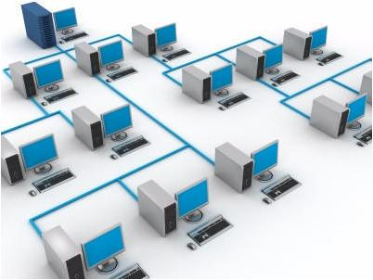
Topic, Problems, and Challenges
Game Topic:
Computer virus tracker in a computer system
Locate and attack malware
Incorporate computer and network structures
Notes:
You are a computer virus tracker. You live inside a computer and travel the network looking for viruses and malware. When some are detected, you have to travel to the infection site and launch anti-virus software discs at the malware minions. Escalate the adventure from basic network bugs to a Web Bot boss. Take note in design to include computer networking structure and devices.

Slide 3


Topic, Problems, and Challenges
Problems/Challenges
Fairly open theme
Many choices for gameplay mechanics
Network/Computer Elements
Attention Grabbing
Replayability
Notes:
Goal: Try to create a fun, engaging game that nevertheless demonstrates the concepts of computer networks and systems,

Slide 4
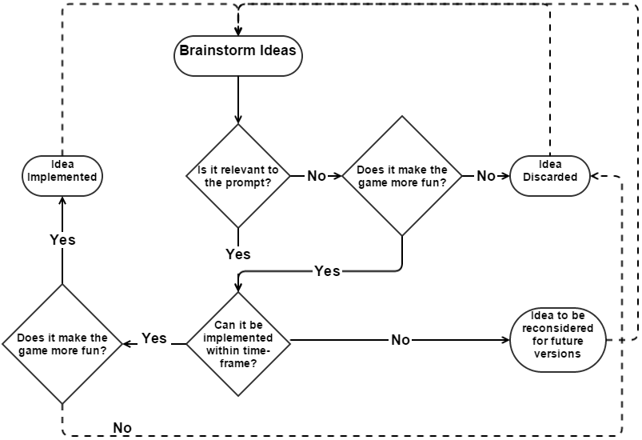
Planning Process
Overall Planning Stage:
Face-to-face and digital meetings
Brainstorm main game concepts
Brainstorm and take notes for game elements
Collaboration during implementation

Slide 5

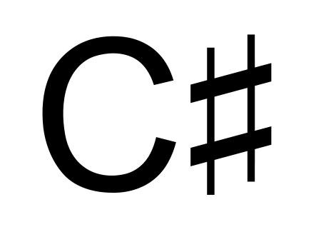

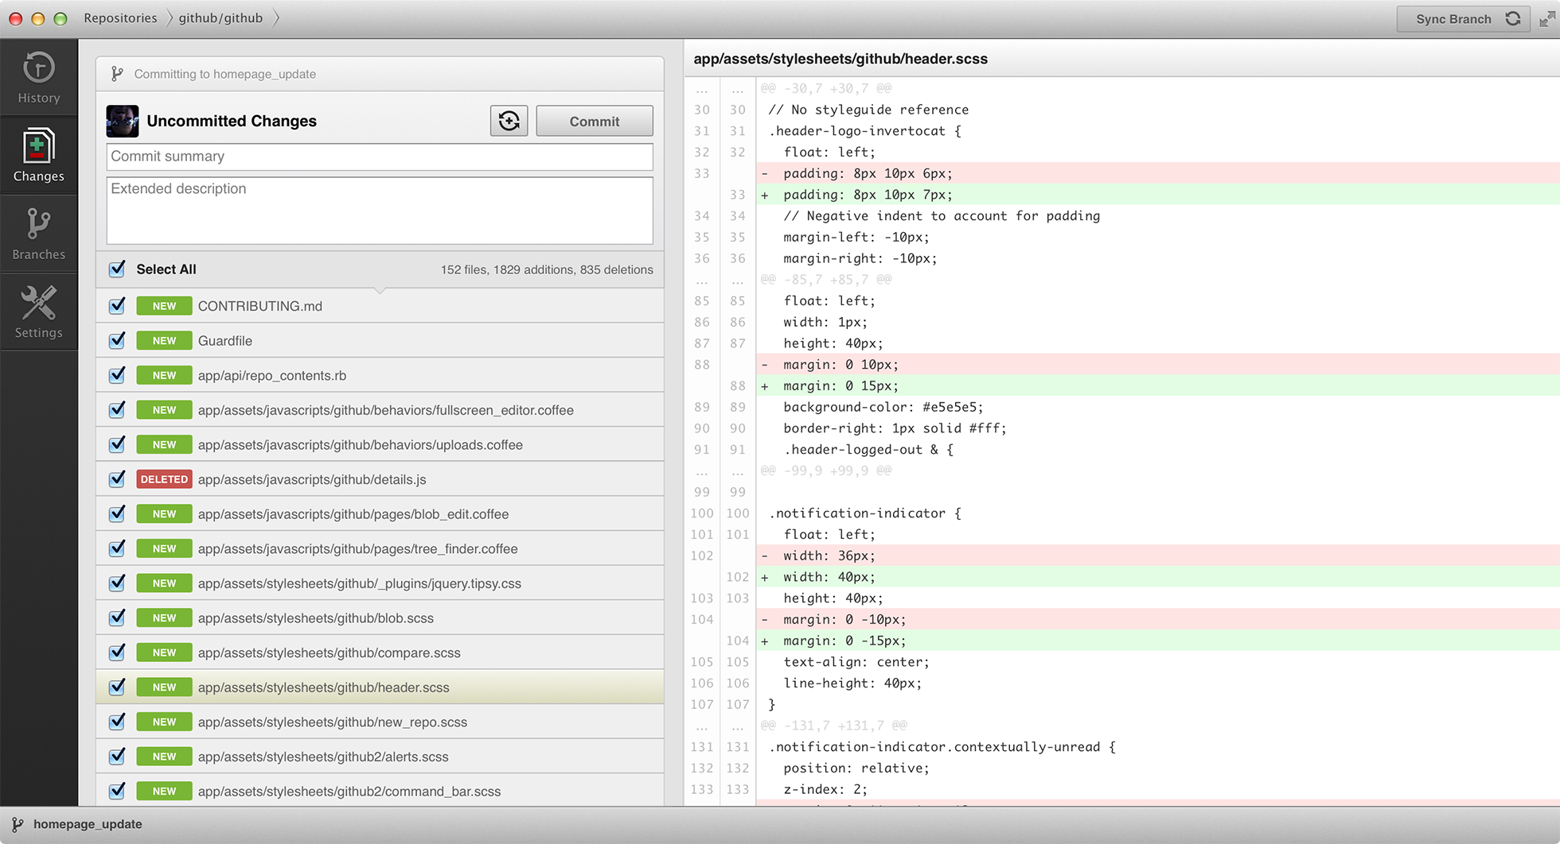

Software Used
Unity
Monodevelop
Blender
GitHub
Adobe Photoshop
Google Drive
Notes:
Biggest choice here: Why Unity?
-Last year written the game was written from scratch in java - time-consuming
-Want to focus less on programming and more on a pleasant playing experience
-Wanted to work in 3D
-Extremely beginner friendly- tons of tutorials. Anything possible with it.
Blender gives an open source platform for which we did our 3D Modeling, with extensive tutorials online
--Integrates well with unity
Github allowed collaboration and a smooth handover of files to allow each of us to work on different pieces, then combine them together
--Source Code Manages
Google Drive documents were helpful especially in the planning stages to serve as a cooperative platform
--Slideshow!

Slide 6
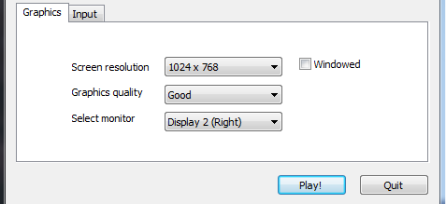
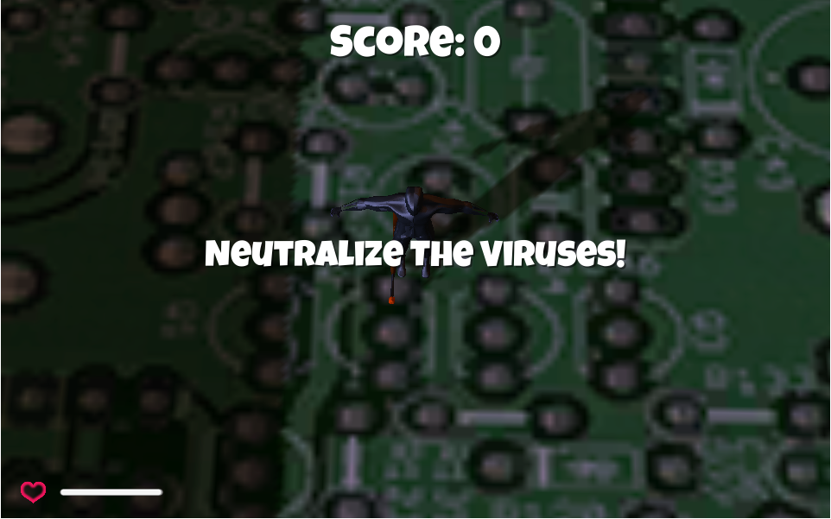
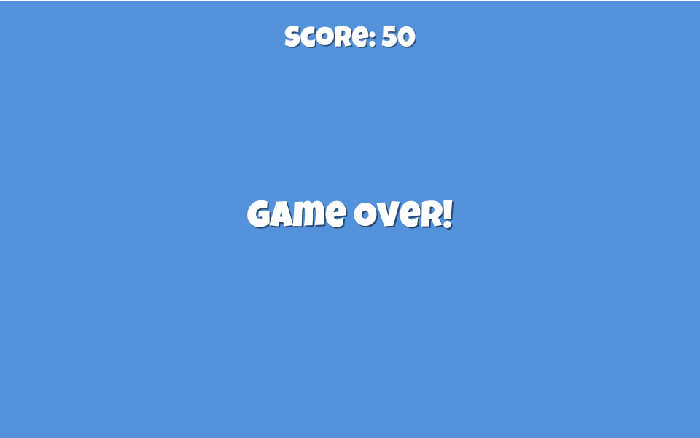
User Interface and Interactions
Configuration panel on Startup
Controls customizable
Score displayed on top
WASD/Arrow Keys to move
Left Click (Or Ctrl) to fire weapon
Notes:
-Most familiar controls to pc gaming audience by default, however, they can be changed to the players liking

Slide 7
Gameflow
No
Spawn
New enemies
teach about viruses
No
Are all sites cleaned?
Yes
Are all computers cleaned?
Fight enemies
Portal opens to next “computer” (level) in the network
Yes
Find Infection Sites
Clean Infection Sites
The End!
You cleaned the network!
= implemented

Slide 8
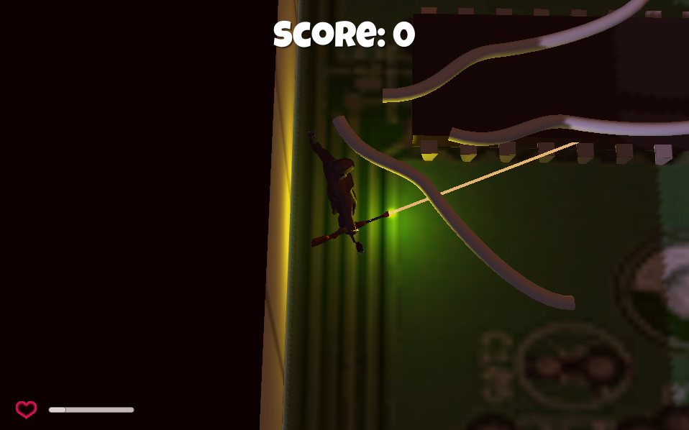
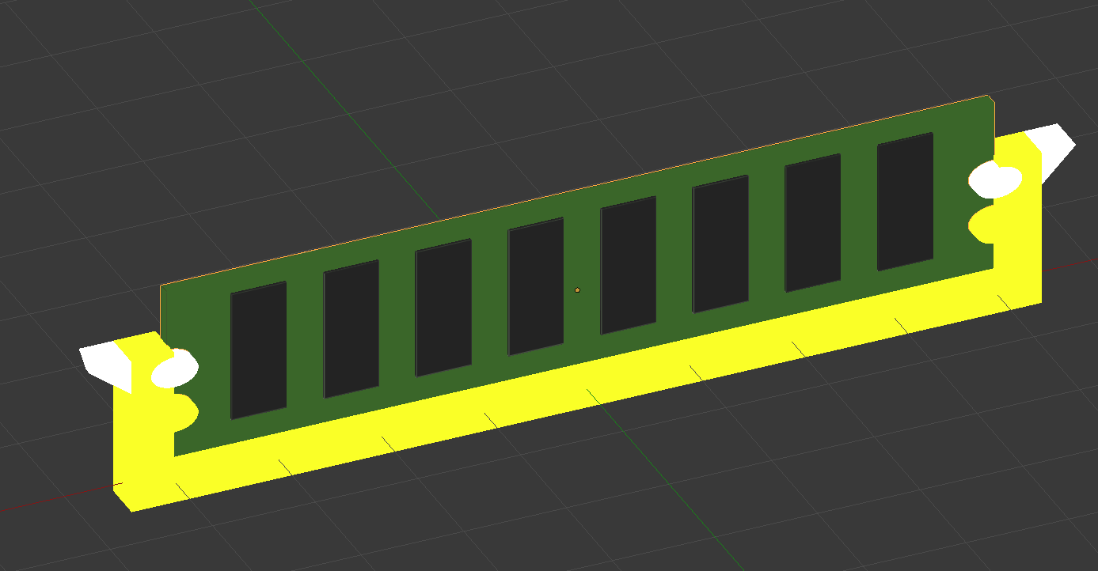
Gameplay
Entertain/Engage
Limited health
Constant spawn
Educational
Displays infected modules
Displays virus names
Various discs

Slide 9
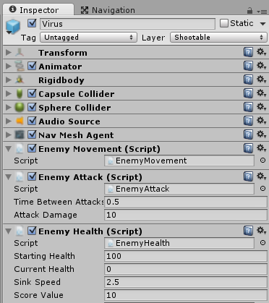
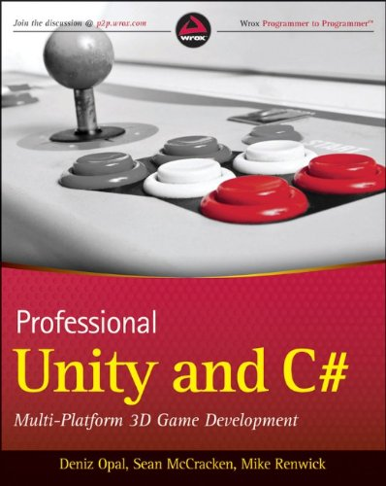
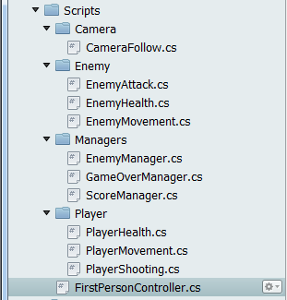
Programming
Modules/Structure
Scripts are attached to objects
Flow
Scripts are called on construction, trigger and update
Commenting
Reminders, clarifications, and explanations
Why C#?
Notes:
Scripts are attached to objects. Simple enough- scripts execute only if object is on screen. If 5 are on screen, it executes 5 times, once for every object.
Scripts called on construction, trigger and update
Construction- when the object first joins the scene. Mostly setting things up to have references to other objects
Trigger- you can add trigger colliders to objects. When two of them collide it tells scripts to execute trigger functions if they have them
Update- Every frame, every script of every object in the game has its update code called. Movement and shooting are two things done here.
Commenting
There are clear reasons to comment. For our next iteration of the game we’re adding comments to every block of code to make it easier to look through it all.
Why C#? -Collections
-Features like collections (data structures)
-Unity Javascript is a modified version with things like types instead of vars
-Unity Boo is unknown and unlike javascript and C# won’t come in handy anywhere else

Slide 10
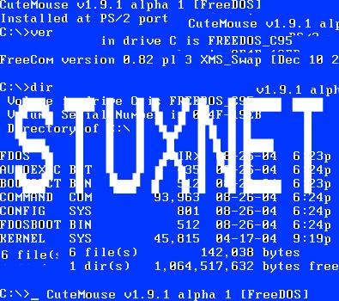
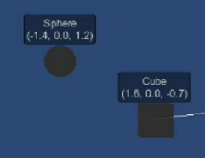

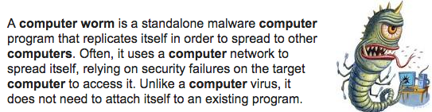
Ability To Meet Educational Goals
Specific Viruses
Described in popups
Computer Networks
Computer Hardware
Travel from disc to RAM and head for network
Information
The Heartbleed Bug was a serious vulnerability in the popular OpenSSL cryptographic software library.

Slide 11
Thank You!
Questions?
TRC Productions © 2014

